Slide 1
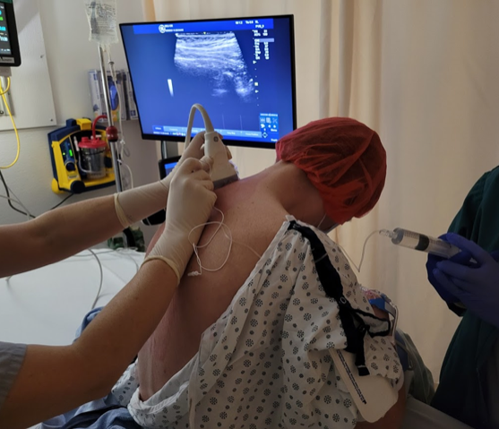
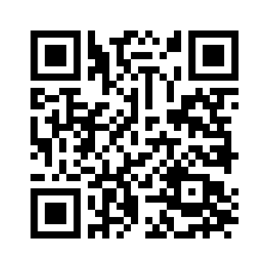
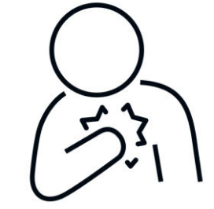
– Participants Needed – Study at St. Paul’s Hospital
BILATERAL PARAVERTEBRAL BLOCK FOR IMPROVED RECOVERY AFTER OPEN HEART SURGERY
Pain following open heart surgery can be severe and impact your recovery.
The pain medications like opioids, alleviate pain but can be associated with side effects like nausea, vomiting, delirium, sedation, constipation, and breathing problems.
Nerve blocks can provide an alternative pain relief with improve side effect profile.
We want to explore if paravertebral nerve blocks can improve your recovery after heart surgery
What is a paravertebral block?
Freezing medication is injected into the nerves on either side of the back to reduce the sensation of pain.
The procedure itself is not new, as it is routinely performed on breast surgery patients to help with chest pain relief following surgery.
Scan the QR code to learn more!
You may be eligible to participate if you are:
Age 19 years or older
English-speaking
Scheduled for open heart surgery
Pass a cognitive screening test
If you participate, you will be randomly assigned into receiving the nerve block or saline injections
To keep the results of the study fair, you will not know which you are receiving .
To participate or ask questions, please contact:
Dr. Terri Sun | Principal Investigator
E: tsun@providencehealth.bc.ca

